Slide 1
St Francis of Assisi School Newton
ANNUAL REPORT to the community 2023

Slide 2
We acknowledge the Kaurna people, the traditional custodians of this land, and pay our respects to the Elders past, present and emerging for they hold the memories, the traditions, the culture and hopes of Indigenous Australia.

Slide 3
About our school

Slide 4
Our school was established by the Capuchin Friars with the help and dedication of the St Francis of Assisi Catholic community in Newton. This Franciscan foundation formed and continues to be the basis for the development of our spirituality. We opened in 1964 under the spiritual guidance and leadership of the Josephite Sisters. We currently have an enrolment of approximately 260 boys and girls from Reception to Year 6. Our school strives to appreciate, develop and celebrate the skills and differences in all members of our community. We understand that diversity and creativity are gifts from God. We strive to develop a culture of lifelong quality and meaningful learning. We believe that the Gospel values and our spirituality develop attitudes and skills which give our students a sense of hope and confidence that they can make a difference to their lives and contribute to their local and the wider community. We are a school with up-to-date resources and equipment in flexible and modern learning spaces. We have a laptop program for Years 3-6 and have extensive use of ICT (including MacBooks and iPads). We create an enriched learning environment with a focus on the intellectual depth and significance of our learning practices. We provide many sporting and extra-curricular activities and we support families with an Out of School Hours Care service. Our specialist subjects include Performing Arts, Sport and Italian.

Slide 5
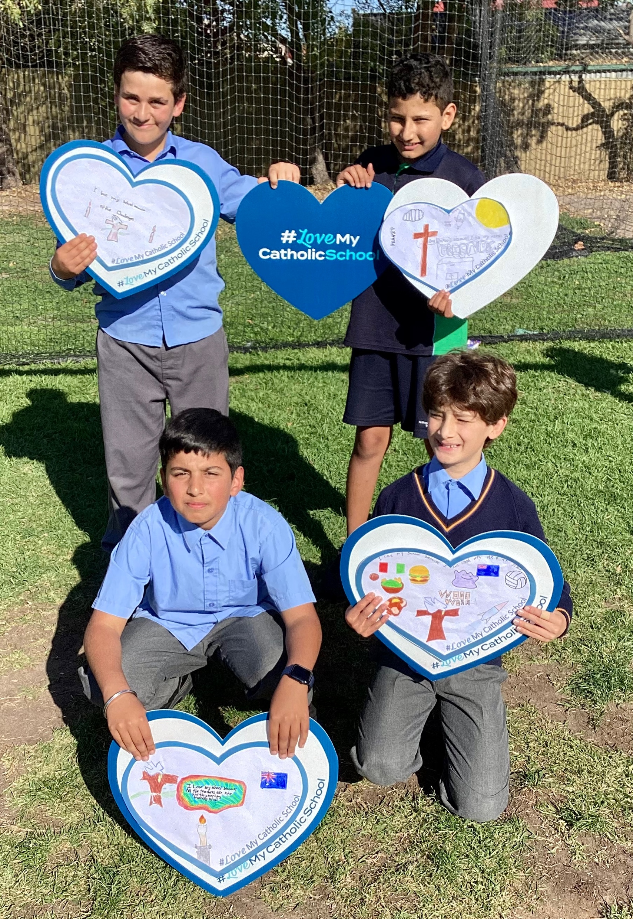
Principal’s reflection
During 2023 the school underwent significant leadership change. James Meiksans resigned from the position of Principal after having been on leave for four terms. Angela Morrison had replaced James up until this time. The position of substantive principal was advertised and appointed, with Scott March to commence his tenure at the beginning of 2024. Angela continued in a part time capacity in Term 3 and Kerri Dent was co-principal for Term 3. In Term 4 Kerri was the sole Acting Principal.
Thank you to Melissa Canil, our Assistant Principal Religious Identity and Mission who took on a far greater leadership role in the spirit of St Mary MacKillop – ‘Never see a need without trying to do something about it.’

Slide 6
Principal’s reflection
During Kerri’s tenure we finalised our Strategic Plan for 2024 – 2026 which will guide all our decision making going forward.
We achieved much during 2023. The outward reflection of the school continued smoothly. Our relationships with the broader community were strengthened with a particularly close connection with Green Leaves Early Learning Service.
Our School Concert was a fantastic success and took place in Term 3 in 2023.
Our staff undertook various professional learning experiences including understanding more about nature play, continuing the journey with Maths and English, utilising Blended Therapies to understand children’s emotional wellbeing needs, and a beautiful and much appreciated Staff Retreat at the Sophia Centre.
Our community should be very proud of the staff dedication and commitment to meeting the needs of each and every child. St Francis is indeed a wonderful community to be a part of.
The successes of 2023 can be seen throughout this report.
Scott March
and Kerri Dent

Slide 7
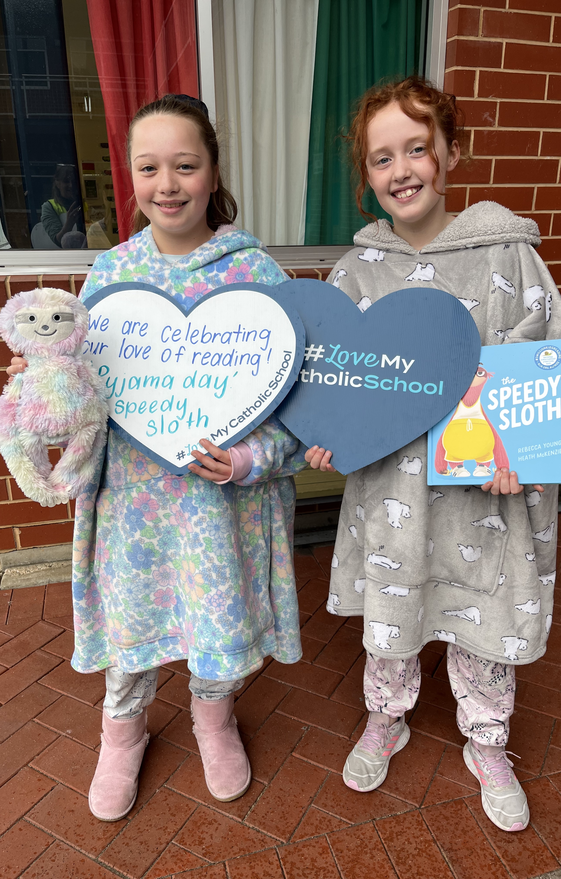
School improvement
During 2022, the school engaged in a self-assessment process that lead to the development of our 2023 goals. Staff consultation, community consultation, discernment of areas of need, and assessment of ongoing goals was undertaken to establish the plan for 2023.
Our goals are based around the Catholic Education South Australia (CESA) “Living, Learning, Leading Framework” and the CESA “Towards 2027” Strategic Plan.
The following page highlights some of our goals and achievements.

Slide 8
School improvement
Catholic Identity
Faith formation and parish relationships
Professional learning and Staff Retreat Day on Laudato Si’, Pope Francis’ Encyclical on our responsibility to care for God’s creation.
Regular class liturgies.
Learning and Teaching
Continued Professional Learning in Literacy and Numeracy strategies
Teaching staff participated in training days and staff meetings and implemented strategies learned.
Professional Learning in strategies for wellbeing
Wellbeing strategies for staff and children and young people.
Community
Active Parents and Friends group
School Community functions including Quiz Night and Antipasto platters for Sports Day
Resource Management
Development of 10 Year Financial Plan
Setting ourselves up for financial sustainability into the future in order to assist with longer term decision making.
Minor capital works
Resurfacing and line-marking of the school hardcourt area (Kiss and Drop zone)
Second Nature Play area developed.
Resource Management
Development of 3 Year Strategic Plan

Slide 9
About our staff

Slide 10
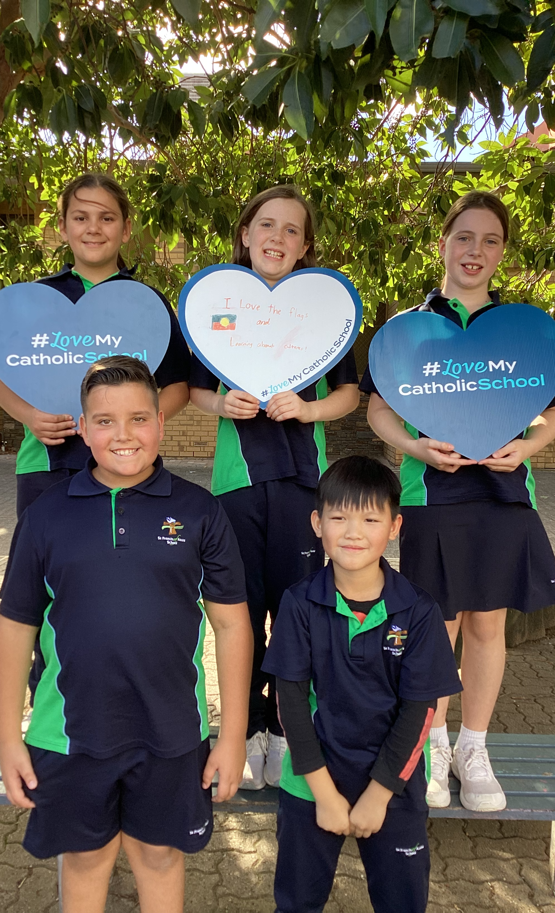
About our staff
Workforce Composition
Teaching Staff
Males | 6
Females | 14
Full Time Equivalent | 15.8
Non Teaching Staff
Full Time Equivalent | 9.6
Indigenous Staff | 0
Full Time Equivalent | 0

Slide 11
About our staff
Teacher Qualifications
We are privileged to have a qualified, staff of lifelong learners.
Among our teaching staff there are Bachelor degrees, Masters degrees and Diplomas.

Slide 12
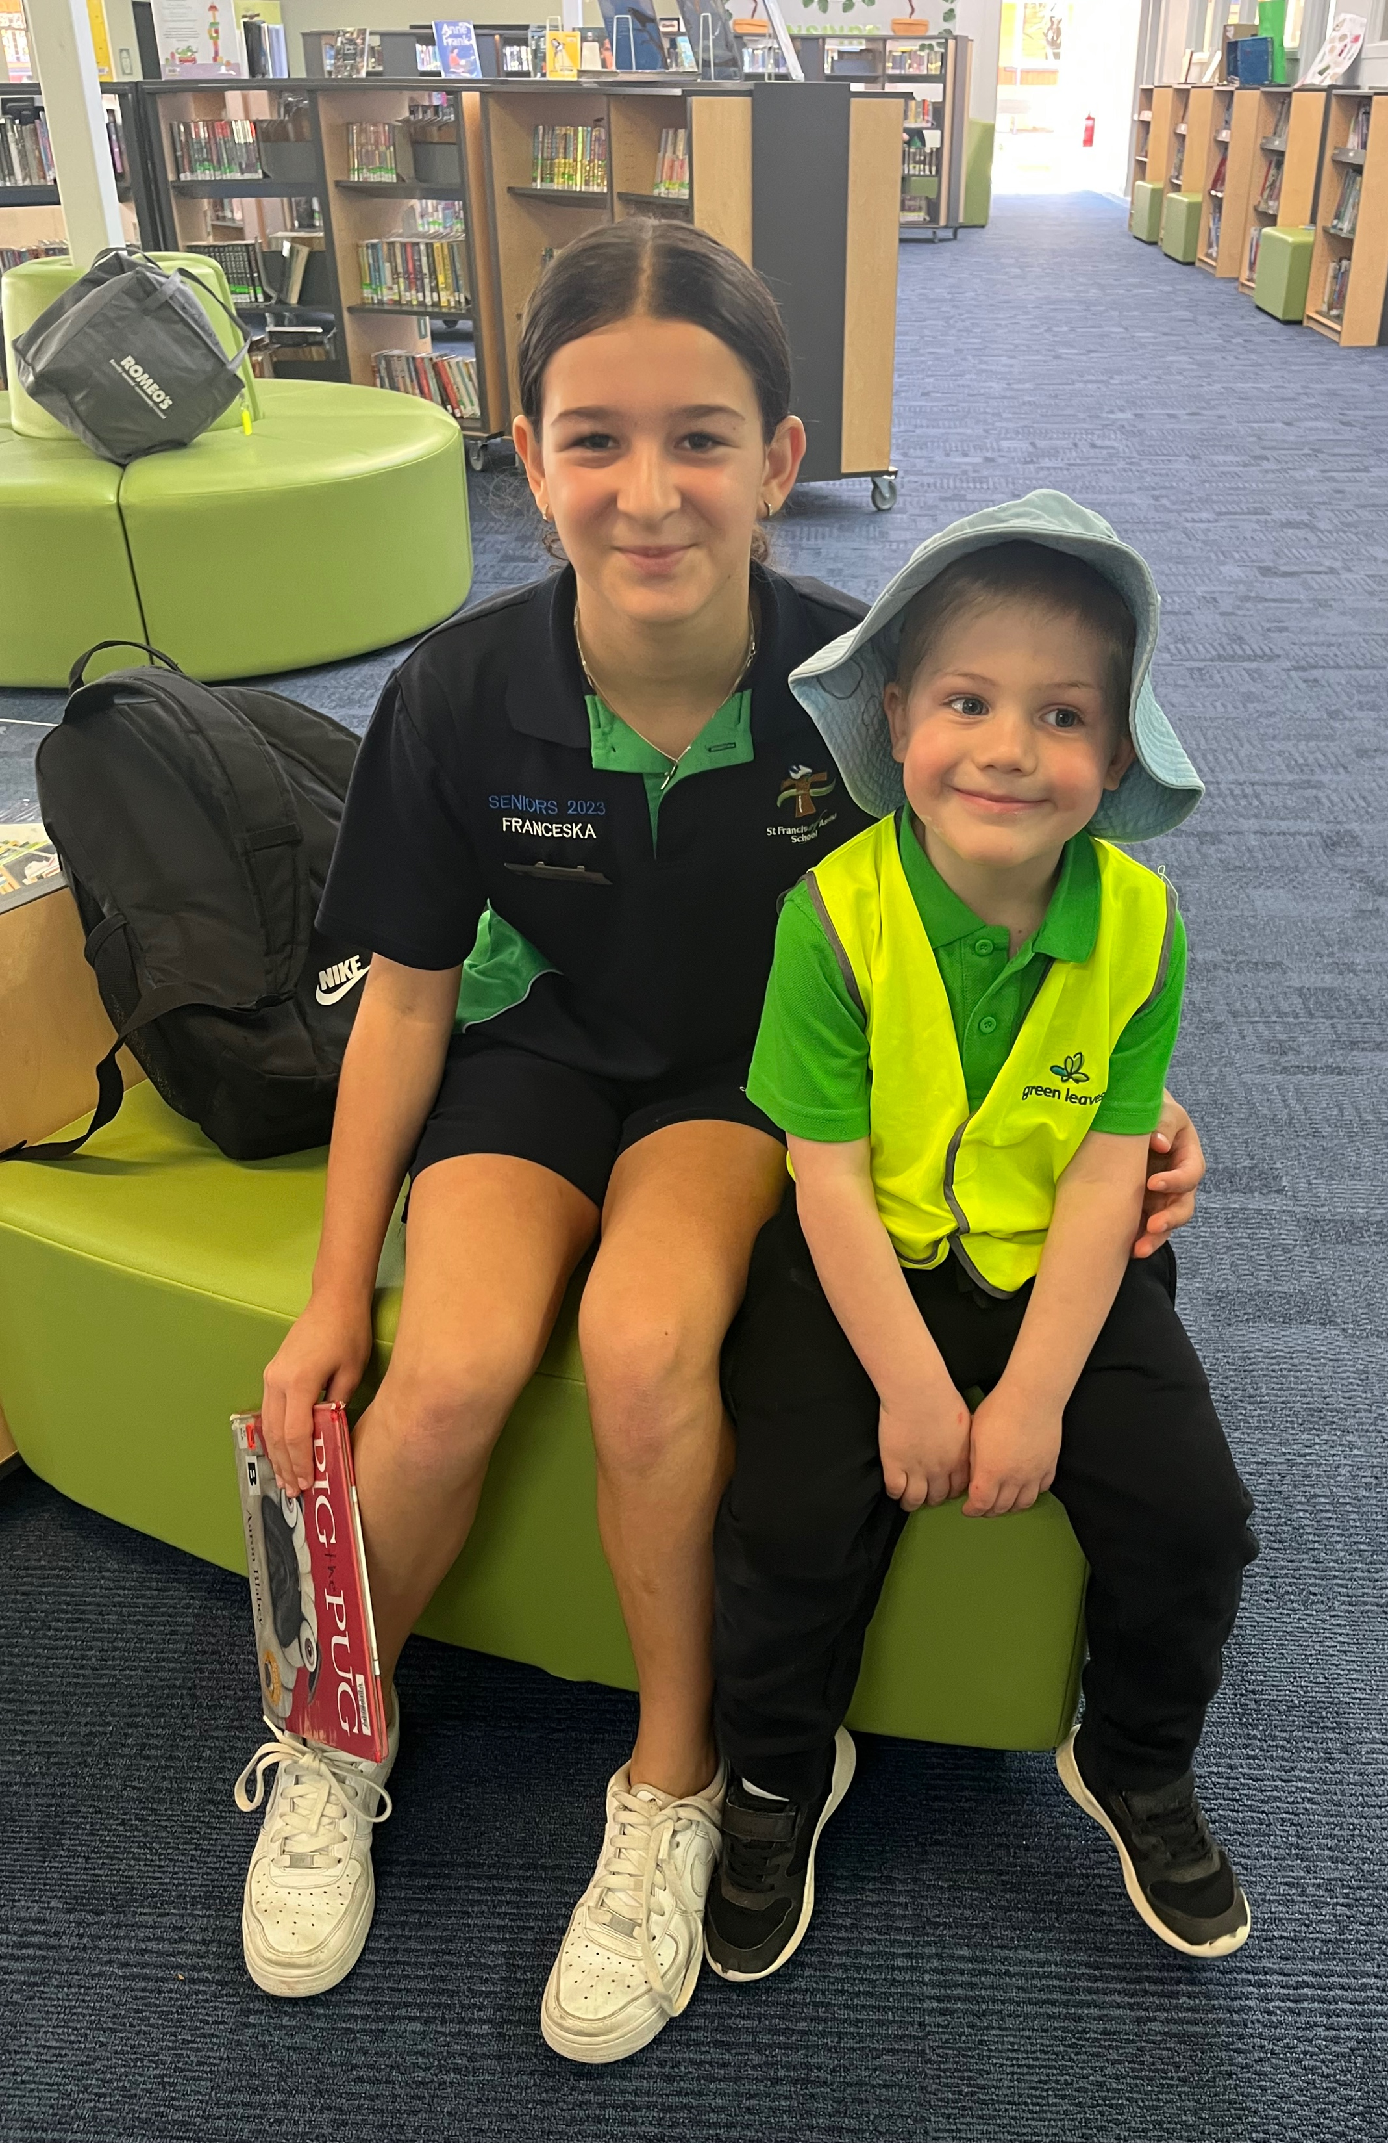
About our staff
Professional Learning
In 2023 all staff participated in professional learning.
We have continued with our involvement with the Primary Mathematics Association and investigating our literacy with Linda Clune.
Staff undertook training in how to provide safe and calm classroom environments to meet the needs of all children in their care
A Staff Reflection Day was held in September at the Sophia Centre. Laudato Si’ was explored lead by our Assistant Principal Religious Identity and Mission. Laudato Si’ is Pope Francis’ Encyclical on ecological conversion and our call as Catholics to look after our environment.

Slide 13
About our students

Slide 14
About our students
At August Census 2023 the population of the school was 263 children. In 2023 the August Census included 17 Mid-Year intake Reception children.
 | Reception | Year 1 | Year 2 | Year 3 | Year 4 | Year 5 | Year 6 | Total
Girls | 20 | 18 | 15 | 19 | 22 | 17 | 18 | 131
Boys | 23 | 18 | 16 | 17 | 19 | 24 | 14 | 132

Slide 15
About our students
To Be Completed
Attendance
Year Level | Total for year
Reception | 13.04
Year 1 | 11.19
Year 2 | 10.22
Year 3 | 11.26
Year 4 | 8.62
Year 5 | 10.47
Year 6 | 9.96
Average | 10.68
Student non-attendance is advised by the parents using the Audiri App.
If absenteeism is unexplained families are followed up with a phone call.
Our attendance rates remain lower than pre-COVID as families continue to take the opportunity to visit family overseas and take holidays.

Slide 16
About our students – learning outcomes NAPLAN
Our NAPLAN results are tracking well. We continue to develop ways of further improvement in the Literacy and Numeracy of our children and young people.
Year 3 | Mean Score | Proficiency level
Reading | 408.5 | Strong
Writing | 433.6 | Strong
Spelling | 407 | Strong
Grammar and Punctuation | 414.6 | Strong
Numeracy | 407.5 | Strong
Year 5 | Mean Score | Proficiency level
Reading | 474.2 | Strong
Writing | 491.4 | Strong
Spelling | 489.1 | Strong
Grammar and Punctuation | 485.9 | Strong
Numeracy | 483.2 | Strong

Slide 17
Our community

Slide 18
Parent satisfaction
Each year all stakeholders in the school are invited to participate in the Catholic Education SA Living Learning Leading Survey. The maximum score for each question is 6. The scores are average across all participant responses.
The education at the school encourages my child/ren to
develop their faith and spirituality Score: 5/6
The teachers believe that my child/ren will succeed Score: 5.25/6
The teachers understand my child/ren’s needs Score: 4.92/6
In general, my child/ren enjoy going to school Score: 5.08/6

Slide 19
Student satisfaction
Each year all stakeholders in the school are invited to participate in the Catholic Education SA Living Learning Leading Survey. The maximum score for each question is 5. The scores are average across all participant responses.
Years 2, 3, 4 Years 5 & 6
My teachers give me extra help if I need it Score: 4.63 & 4.37
My teachers support me to improve my school work Score: 4.67 & 4.29
I have a choice about the way that I learn in class Score: 4.12 & 3.94
I feel welcome at the school Score 4.57 & 4.45
The classrooms are welcoming places to learn Score: 4.64 & 4.31

Slide 20
Staff satisfaction
Each year all stakeholders in the school are invited to participate in the Catholic Education SA Living Learning Leading Survey. The maximum score for each question is 6. The scores are average across all participant responses.
Catholic rituals, symbols and liturgies are an important part of
the school's identity Score 4.81
There is a shared vision for learning Score: 4.62
I effectively incorporate a variety of teaching styles in my
Classroom Score: 5.24
The school has a strong partnership with families Score: 4.62
The students I work with collaborate with me to change my
practices to support their needs Score: 4.71

Slide 21
Finance

Slide 22
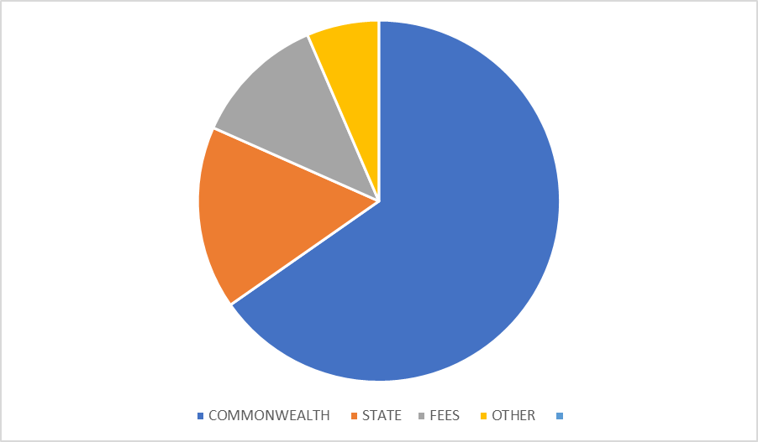
Where our income comes from
2023 Audited Income
The school receives its income from three main sources:-,
1.Australian Government Funding: 2. State Government Funding:
3. Private income from school & fees and levies:
The graph below shows that approximately 65.28% of our funding come from Australian Government, 16.37% from State Government, 11.9% Fees and 6.45% other income.

Slide 23
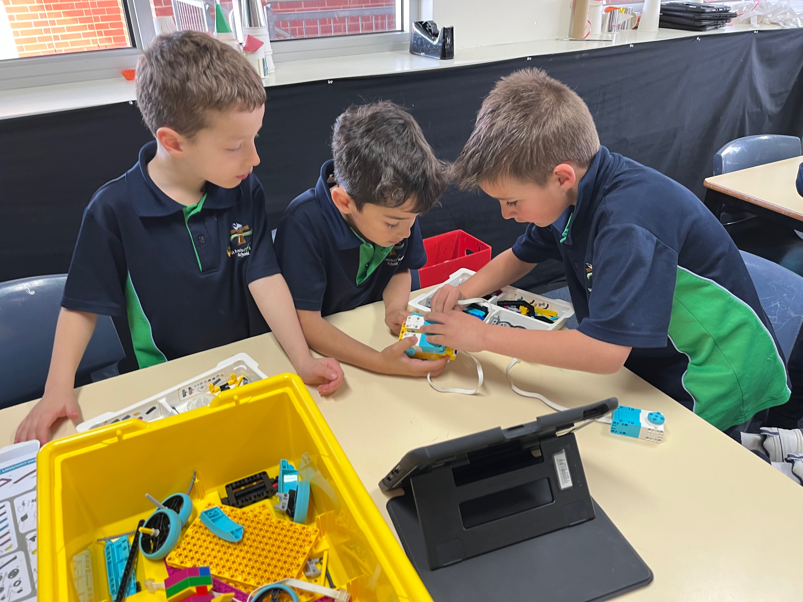
Contact St Francis of Assis School 57 Newton Road Newton SA T 8178 9900 E info@sfoa.catholic.edu.au Facebook: www.facebook.com/SFOANewton www.sfoa.catholic.edu.au

